Slide 1

Octopus Cards
The Reventars
ITM 189

Slide 2
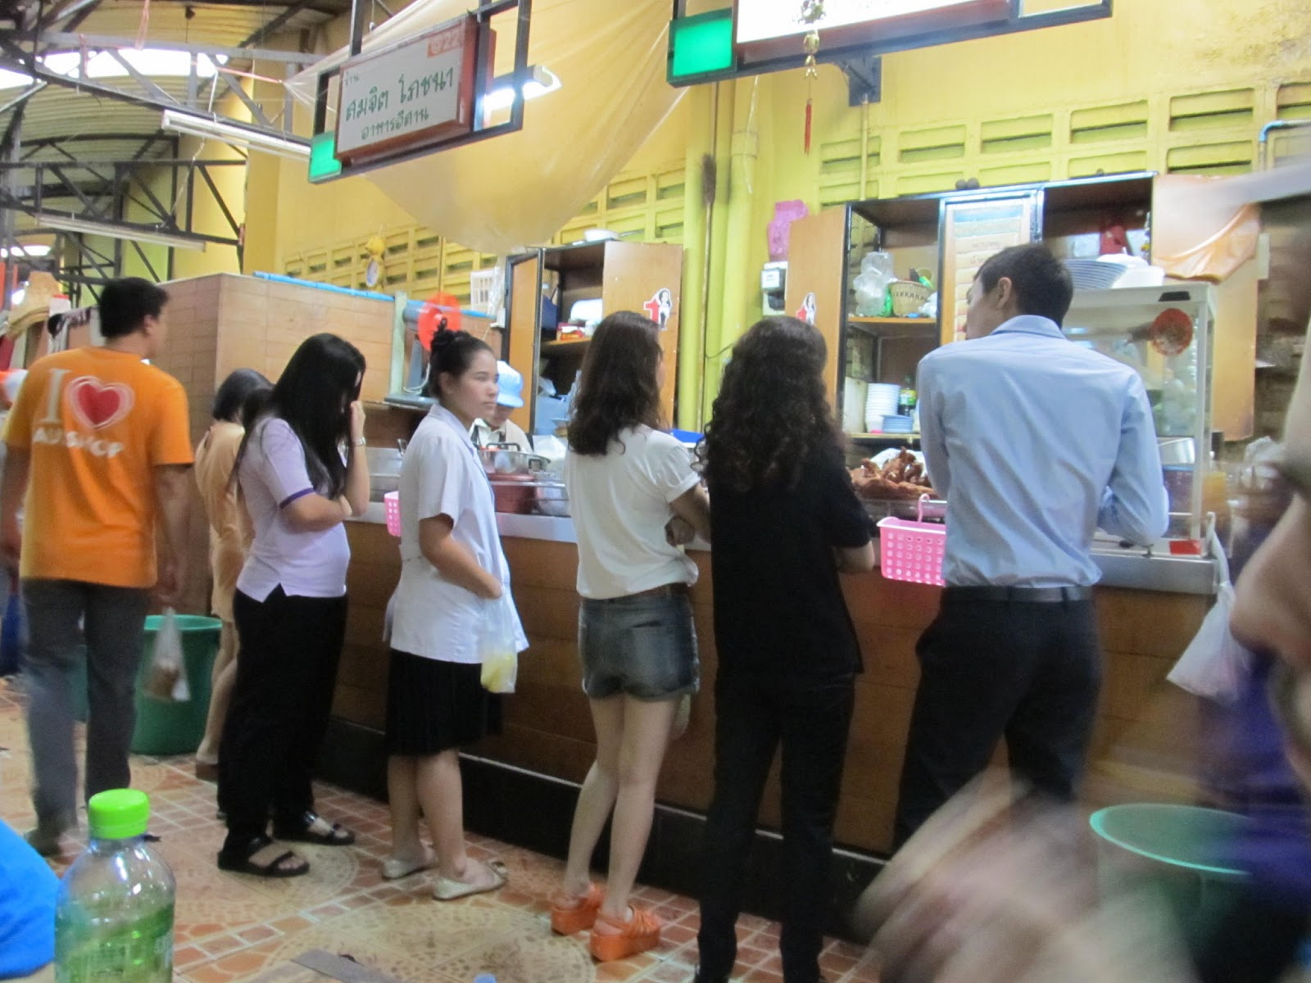
Problem Definition
Transaction inefficiency
Long lines
Counting change
Human Error

Slide 3
Scope
Various food stalls and amenities in the Loyola Schools
JSEC
Gonzaga Cafeteria
Photocopy areas
Other student owned or school owned stores

Slide 4
Assumptions
Ateneo de Manila University as main proponent
8000 students in the Loyola Schools
8 units of photocopying stalls
3 printing stations
41 food stalls
Students carrying the costs for the project at a fixed rate
Establishments carrying the costs for the project at a sales commissions

Slide 5
Stakeholders
Primary: Students
Secondary: Establishments

Slide 6
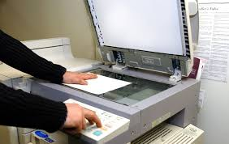
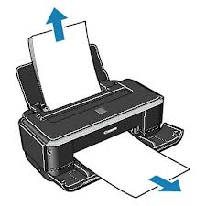
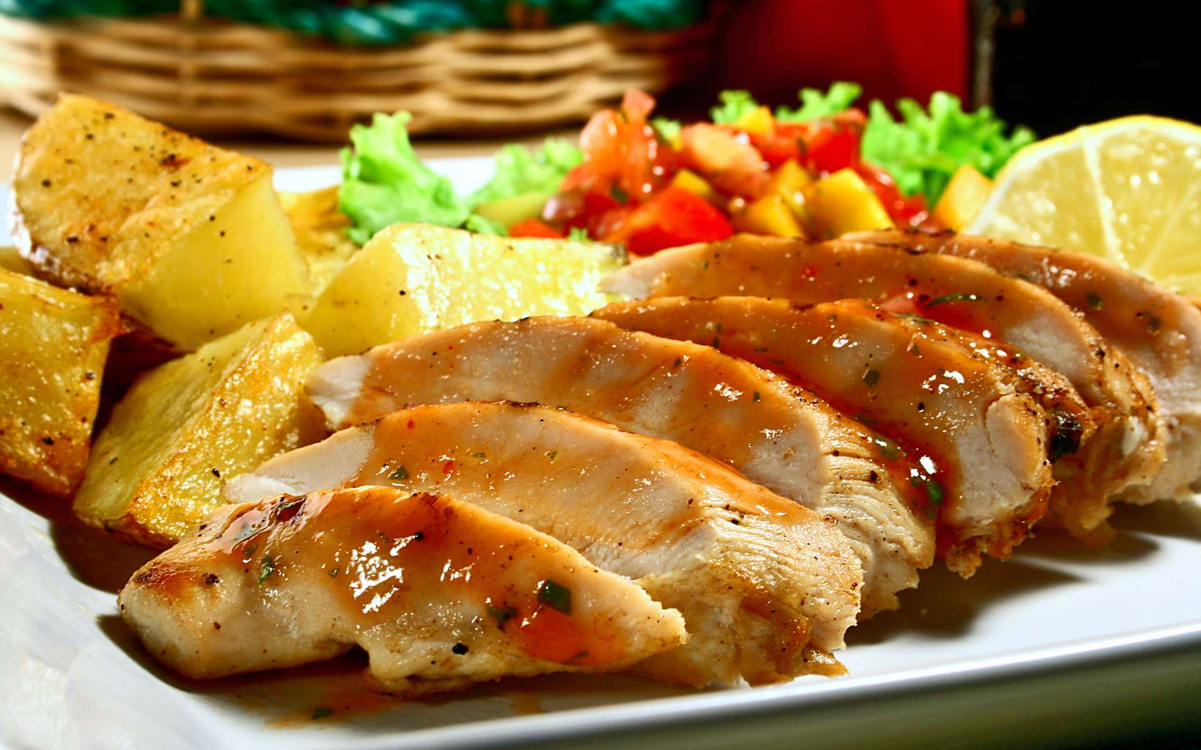
Market Characteristics and Trends
Food
Printing
Photocopying

Slide 7
System
Clearing House Architecture
Frame relay network
Frame service relay provider

Slide 8
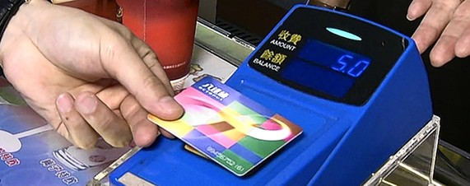
Universal Reader and Writer Platform
Universal Reader/Writer platform supports ISO/IEC 14443 Type A & B and Sony FeliCa
Integrate with existing Octopus devices
Integrate with various payment solutions
Supports LED display, sound and voice messaging
Supports multiple SAME card slots
Linux OS

Slide 9
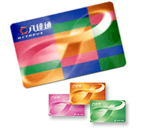
Cards
Transactions as fast as 0.3 seconds
Stable and reliable due to non-contract transactions
Environmentally friend materials used
Easily Reloadable

Slide 10
Add-Value Machines
Top ups through prepaid

Slide 11
Risks
Possible Risks | Probable Impact | Possibility
Loss of card | Low | High
URP malfunction | High | Medium
Server Downtime | High | Low
Electricity Blackout | High | Low
Broken Card | Low | Low
Loading stations malfunction | Medium | Low

Slide 12

Project Roles and Resources
Project Manager
Systems Analyst
Developer
Tester

Slide 13
Implementation Plan
Development
Also included are the analysis and design
Implementation
Maintenance and Support

Slide 14
Cost Benefit Analysis
Analysis Powerpoint

